Slide 1
Mojo Menus
By Bence Toth

Slide 2
Use case diagram

Slide 3
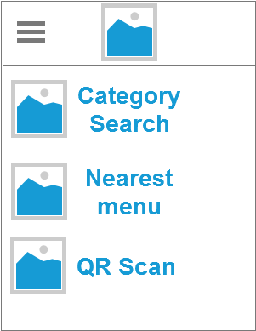
Axure RP Concept
Clean
Simple
Easy to use
Flat Design

Slide 4
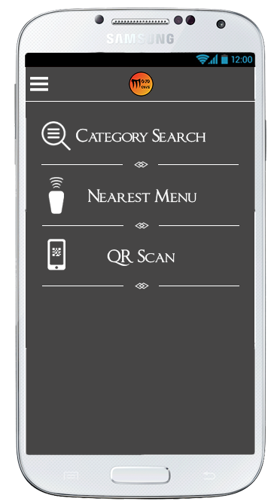
Main concept
Category Search
Nearby Shops
QR Scan

Slide 5
